Slide 1

Algorithm for ODA program and its other Applications

Slide 2

What does the algorithms do
Able to clean the data of unwanted characters words, or slangs
Able to classify or group data based on the same intent
Can summarise those groups of data or create word frequency chart

Slide 3

Use of CRM data for the ODA program
Cluster the CRM data to find different types of intents in the data and classify it based on that.
Find the high frequency words in those clusters and use those words to create meaningful sentences and feed them into oracle digital assistant.

Slide 4

Other use case of our algorithm

Slide 5
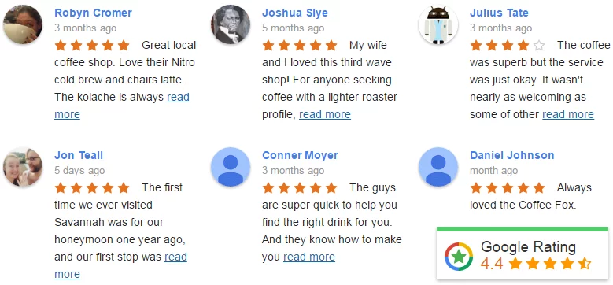
Analysing reviews and media
The algorithm will be able to summarise millions of reviews and give a clear idea of what changes majority of the people would like
The algorithm can also summarise content on media sites.

Slide 6

Preventing Email Overload
Through this software we can summarize the content of the email which will let us skim the email faster
All the formalities and greeting and all the unnecessary content will be removed but keep the important stuff which will save a lot of time
By using our Algorithm skimming emails becomes easy

Slide 7

Malicious Email and links Prevention
. A lot of phishing attacks can be attempted using Emails and detecting them beforehand is a really import task
A recent incident of such Malicious Attack was Petya Virus which effected the Microsoft Windows, and it was distributed the Email
By using our Algorithm, we can detect such email and spam them

Slide 8

What we learned through this internship
By far the most important thing that I learned through this internship is how to portray technical information in a nontechnical way.
Another important thing is meeting deadlines.

